Slide 1
Network Layer: Address Mapping,
Error Reporting, and Multicasting

Slide 2
21-1 ADDRESS MAPPING
The delivery of a packet to a host or a router requires two levels of addressing: logical and physical. We need to be able to map a logical address to its corresponding
physical address and vice versa. This can be done by using either static or dynamic mapping.
Topics discussed in this section:
Mapping Logical to Physical Address
Mapping Physical to Logical Address

Slide 3
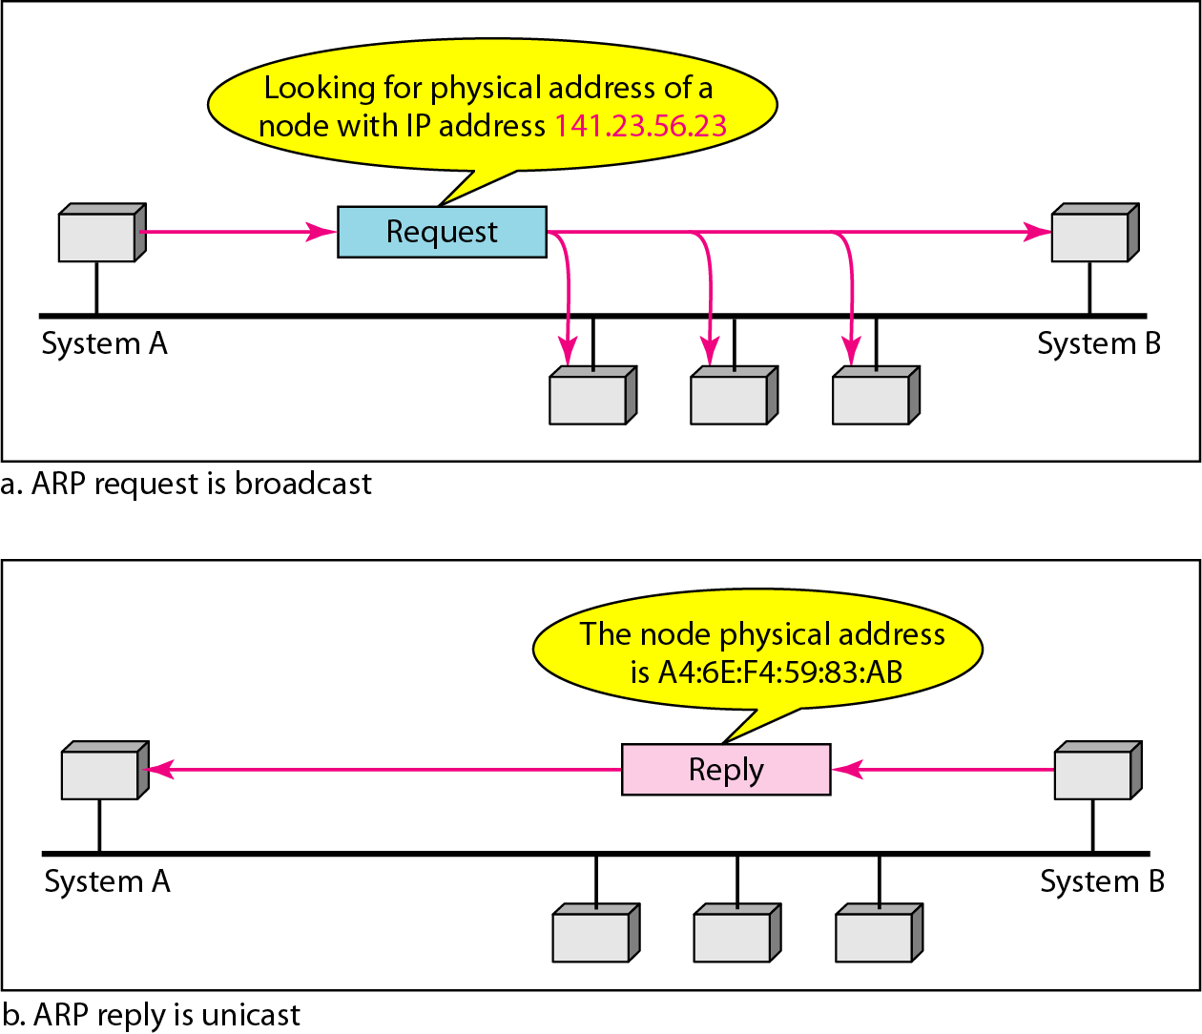
Figure 21.1 Mapping Logical to Physical Address
ARP (address resolution protocol)

Slide 4

Note
ARP can be useful if the ARP reply is cached (kept in cache memory for a while).

Slide 5
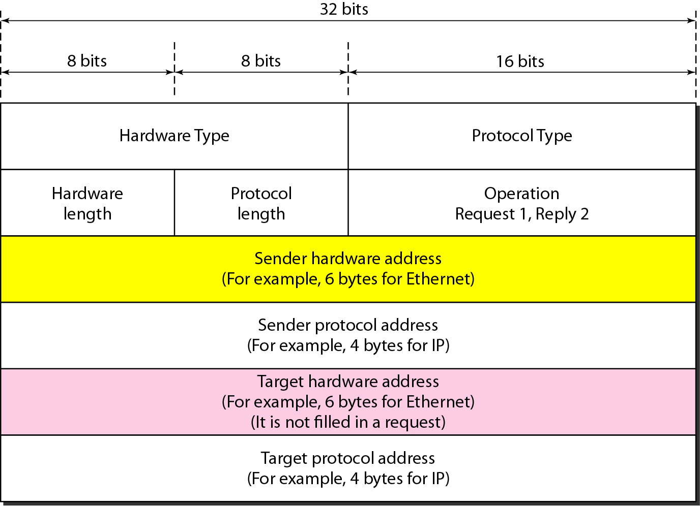
Figure 21.2 ARP packet

Slide 6
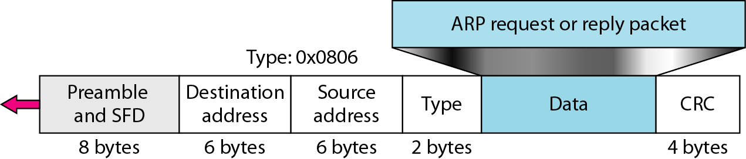
Figure 21.3 Encapsulation of ARP packet

Slide 7
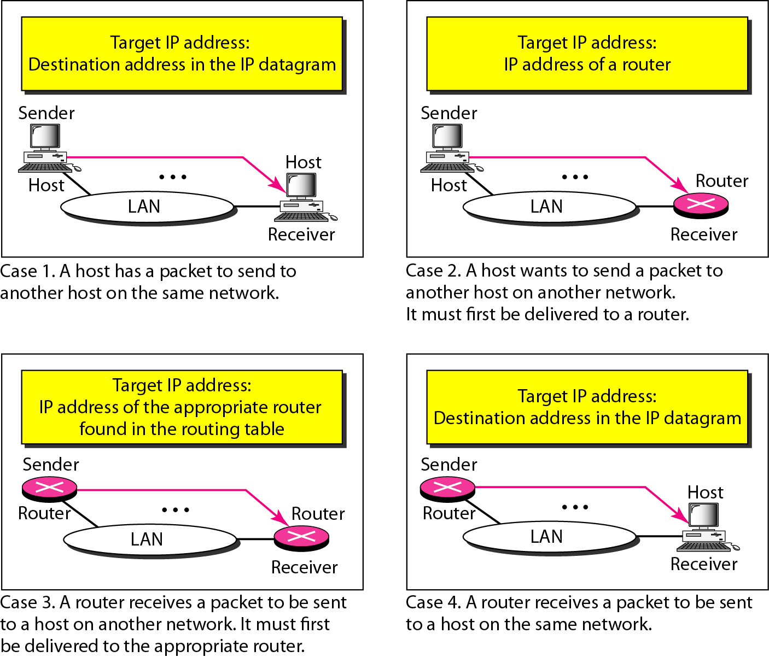
Figure 21.4 Four cases using ARP

Slide 8
Note
An ARP request is broadcast; an ARP reply is unicast.

Slide 9
Example 21.1
A host with IP address 130.23.43.20 and physical address B2:34:55:10:22:10 has a packet to send to another host with IP address 130.23.43.25 and physical address A4:6E:F4:59:83:AB. The two hosts are on the same Ethernet network. Show the ARP request and reply packets encapsulated in Ethernet frames.
Solution
Figure 21.5 shows the ARP request and reply packets. Note that the ARP data field in this case is 28 bytes, and that the individual addresses do not fit in the 4-byte boundary. That is why we do not show the regular 4-byte boundaries for these addresses.

Slide 10
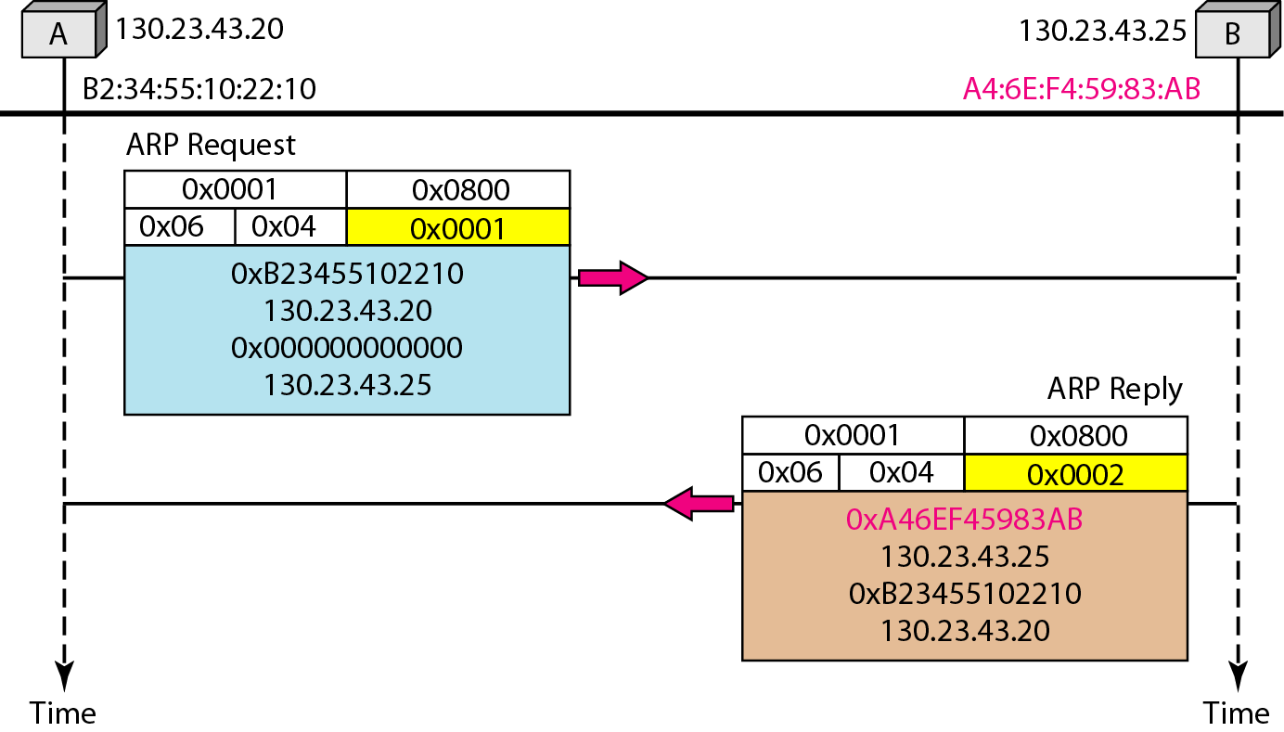
Figure 21.5 Example 21.1, an ARP request and reply

Slide 11
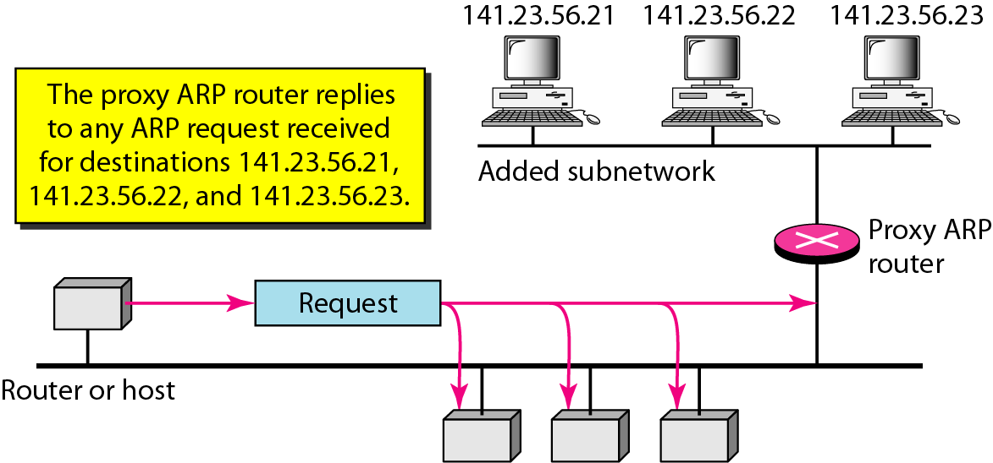
Figure 21.6 Proxy ARP

Slide 12
Mapping Phy to Logical Address: RARP, BOOTP, and DHCP
A diskless station just booted.
An organization does not have enough IP addresses to assign to each station.

Slide 13
Reverse Address Resolution Protocol (RARP)
A machine can use the phy address to get the logical address using RARP.
A RARP messages is created and broadcast on the local network.
The machine on the local network that knows the logical address will respond with a RARP reply.
Broadcasting is done at data link layer.
Broadcast requests does not pass the boundaries of a network.

Slide 14
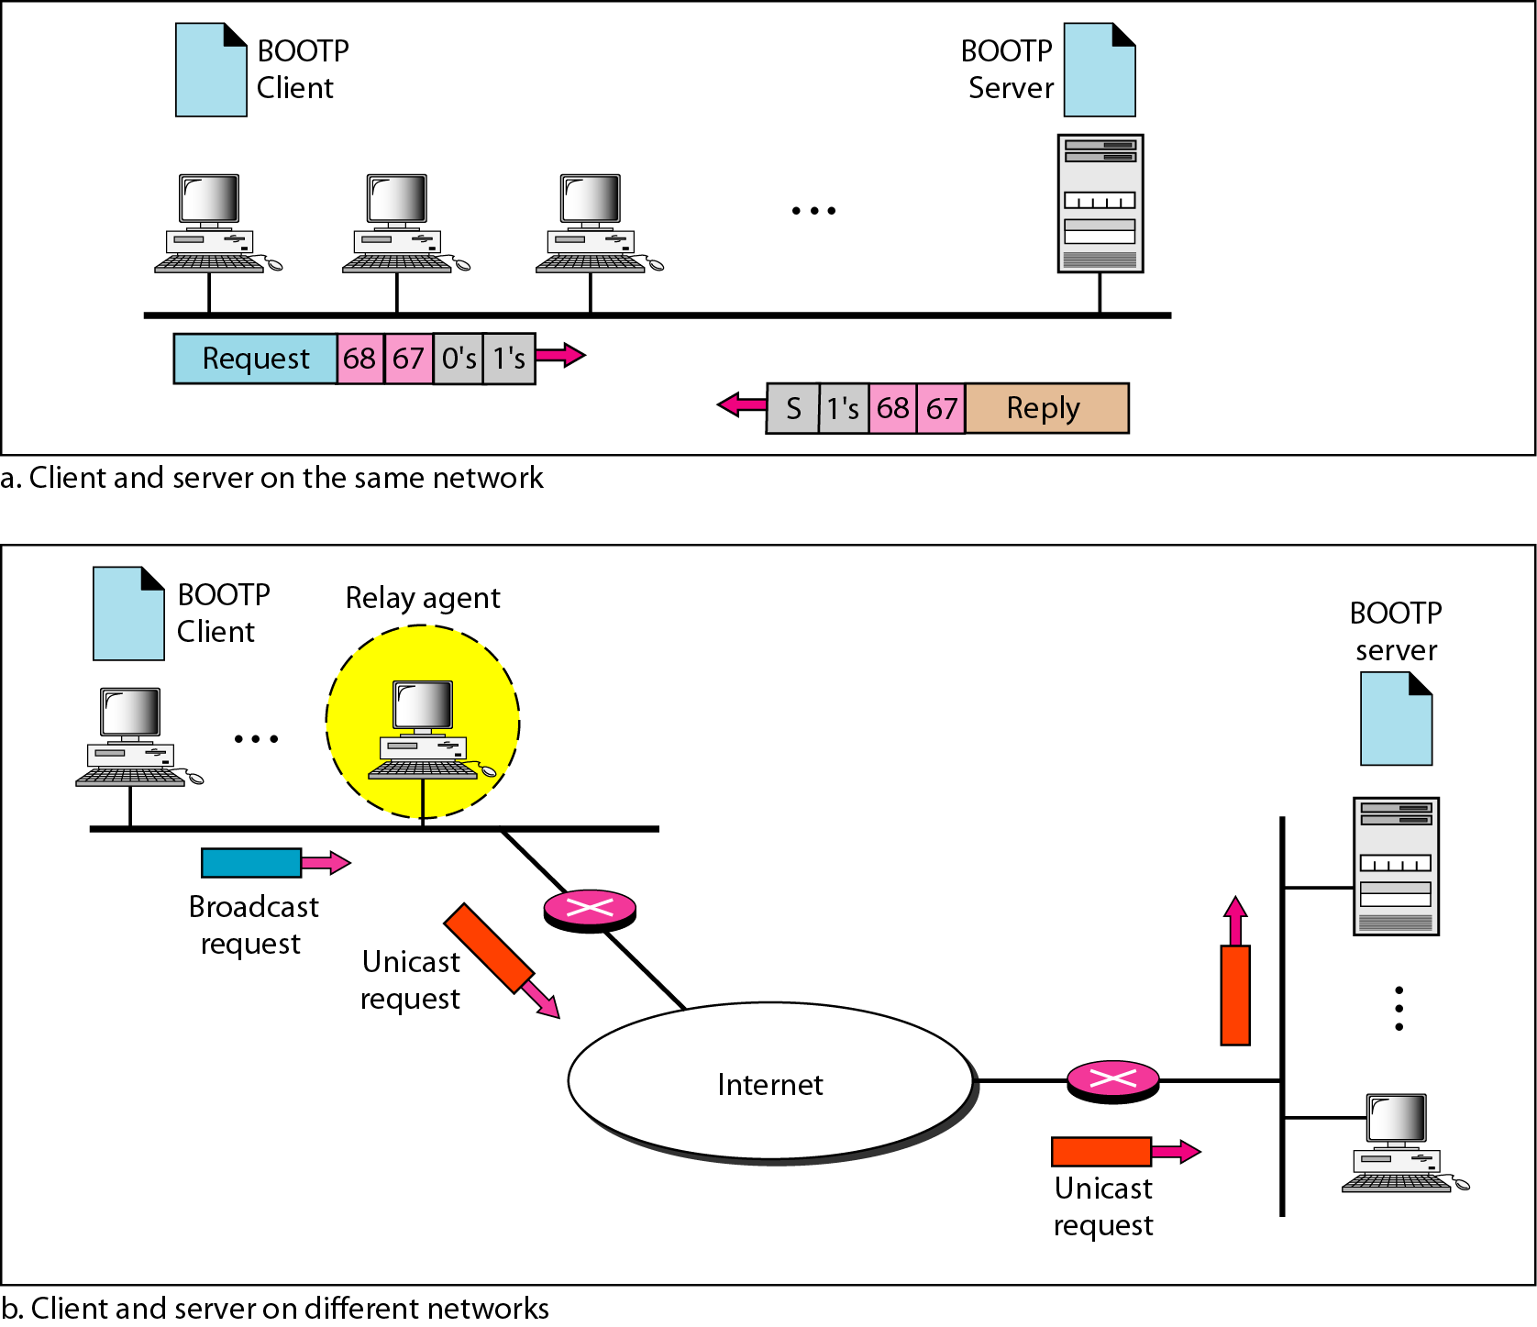
Figure 21.7 BOOTP client and server on the same and different networks

Slide 15
21-2 ICMP
The IP protocol has no error-reporting or error-correcting mechanism. The IP protocol also lacks a mechanism for host and management queries. The Internet Control Message Protocol (ICMP) has been designed to compensate for the above two deficiencies. It is a companion to the IP protocol.
Topics discussed in this section:
Types of Messages Message Format Error Reporting and Query
Debugging Tools

Slide 16
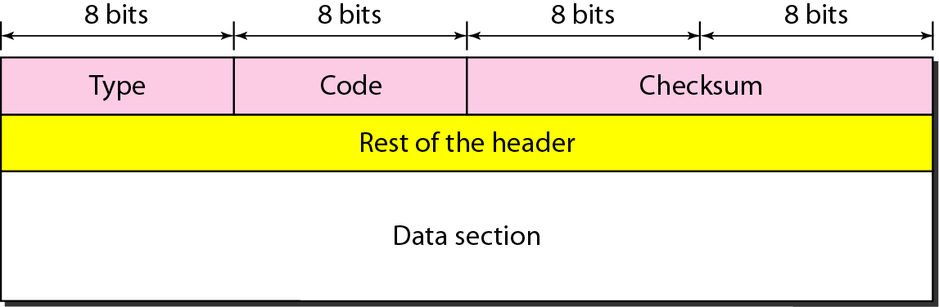
Figure 21.8 General format of ICMP messages

Slide 17
Note
ICMP always reports error messages to the original source.

Slide 18
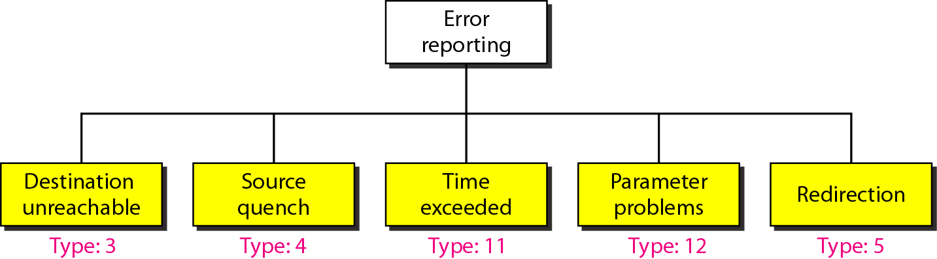
Figure 21.9 Error-reporting messages

Slide 19
Note
Important points about ICMP error messages:
❏ No ICMP error message will be generated in response to a datagram carrying an ICMP error message.
❏ No ICMP error message will be generated for a fragmented datagram that is not the first fragment.
❏ No ICMP error message will be generated for a datagram having a multicast address.
❏ No ICMP error message will be generated for a datagram having a special address such as 127.0.0.0 or 0.0.0.0.

Slide 20
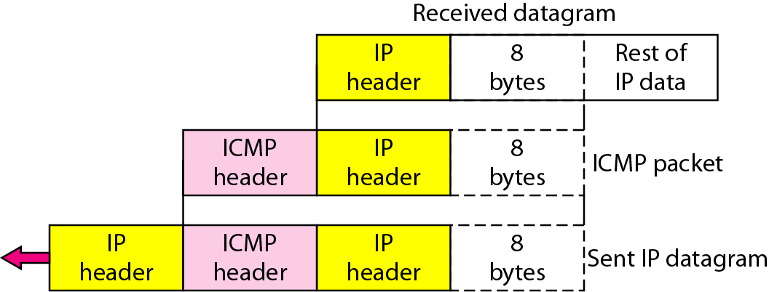
Figure 21.10 Contents of data field for the error messages

Slide 21
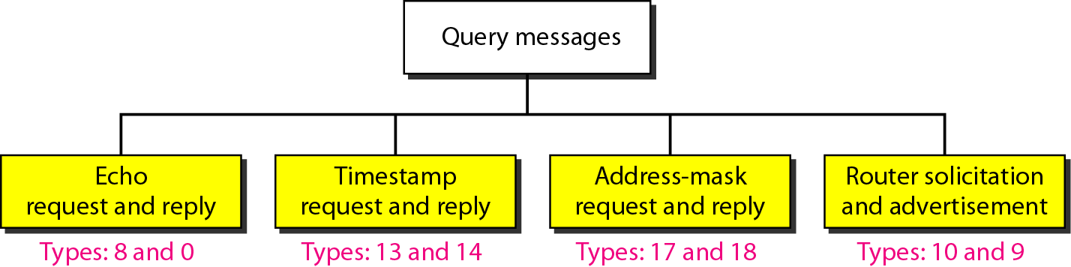
Figure 21.12 Query messages

Slide 22
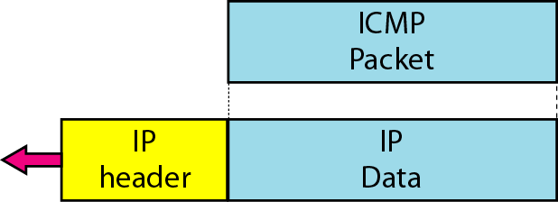
Figure 21.13 Encapsulation of ICMP query messages

Slide 23
21-3 IGMP (Internet Group Management Protocol)
The IP protocol can be involved in two types of communication: unicasting and multicasting. The Internet Group Management Protocol (IGMP) is one of the necessary, but not sufficient, protocols that is involved in multicasting. IGMP is a companion to the IP protocol.

